Slide 1


SAP BTP Training
Cloud Foundry Training

Slide 2

DISCLAIMER
The training content and delivery of this presentation is confidential, and cannot be recorded, or copied and distributed to any third party, without the written consent of Anubhav Trainings

Slide 3

LEARNING OBJECTIVES
SAP BTP CAPM Development
SAP HANA Cloud Introduction
Create SAP HANA Backing service in BTP
Connect, Build and Deploy
Cloud MTA
Add UI Module to mta.yaml
App Router Concept
Implementing App router
Deploy and Test

Slide 4
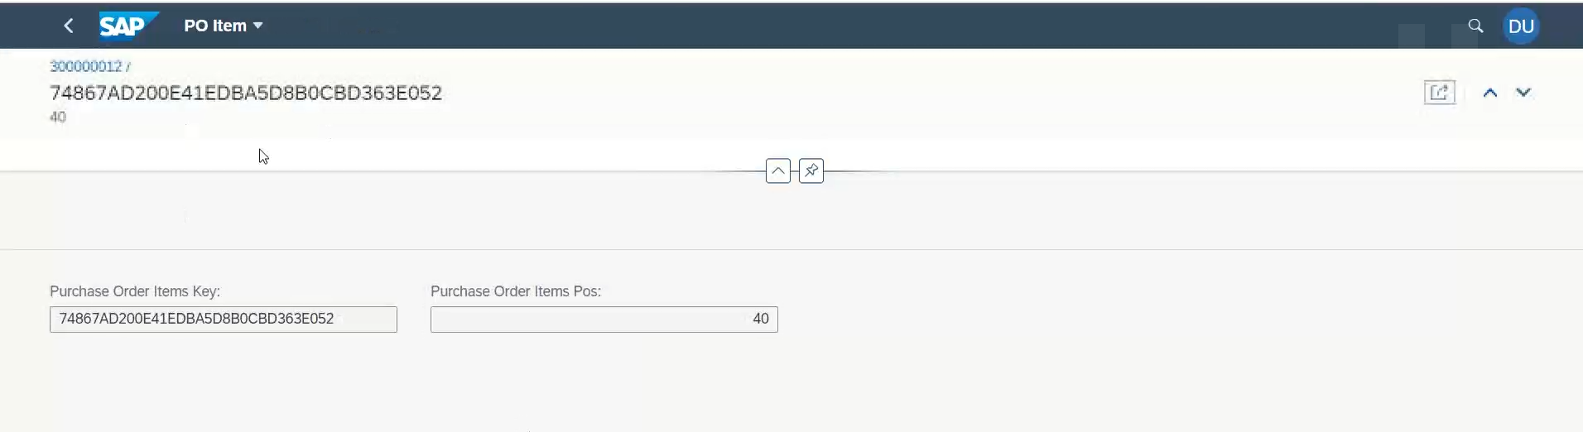
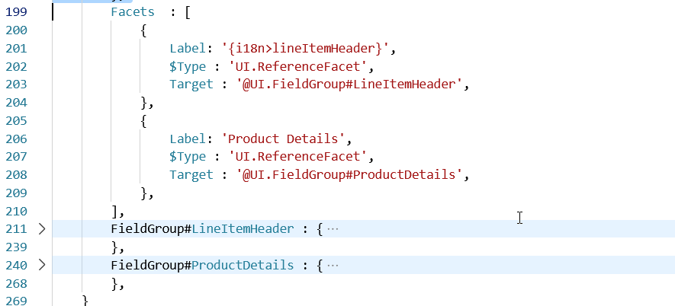
Configure Level 3 Drill down
www.anubhavtrainings.com

Slide 5
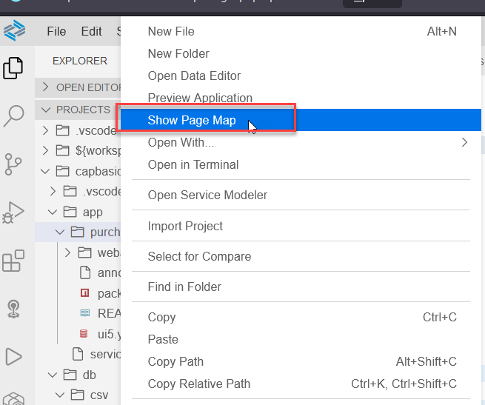
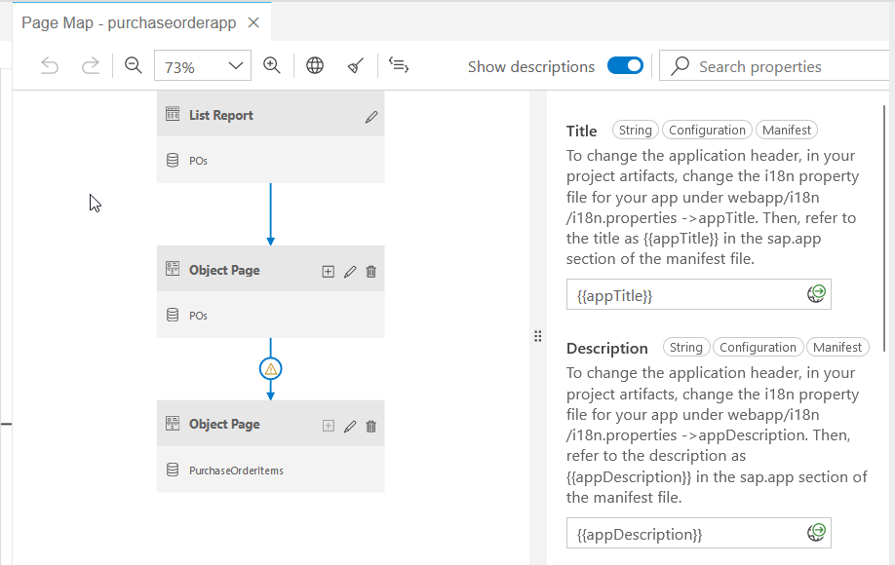
Working with Page Map in BAS
www.anubhavtrainings.com

Slide 6
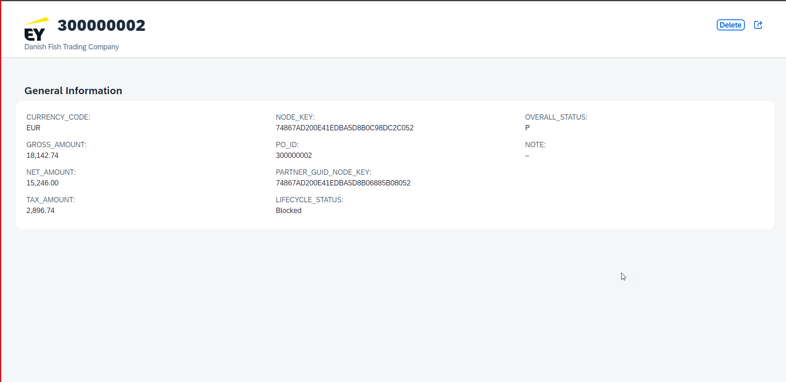












Slide 7
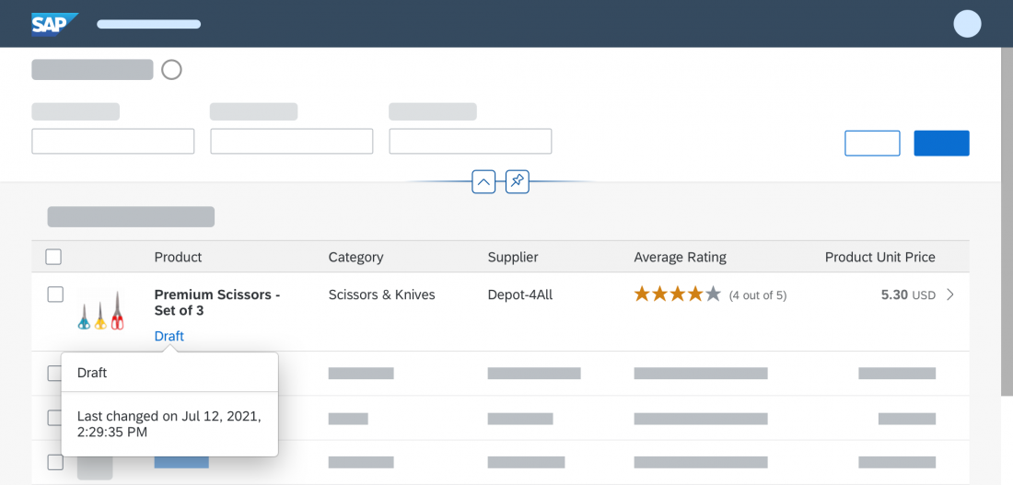
What is draft?
A draft is a temporary version of a business entity that has not yet been explicitly saved as an active version.
Drafts are used:
To keep unsaved changes if an editing activity is interrupted, allowing users to resume editing later.
To prevent data loss if an app terminates unexpectedly.
As a locking mechanism to prevent multiple users from editing the same object at the same time, and to make users aware when there are unsaved changes by another user.
www.anubhavtrainings.com

Slide 8
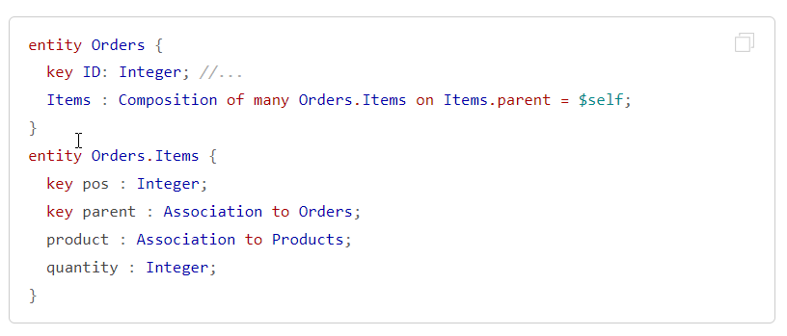

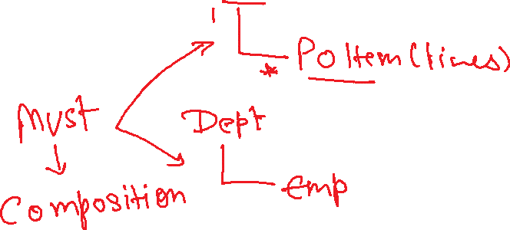


Compositions in CAPM
Compositions constitute document structures through ‘contained-in’ relationships. They frequently show up in to-many header-child scenarios.
Essentially, Compositions are the same as associations, just with the additional information that this association represents a contained-in relationship so the same syntax and rules apply in their base form.
www.anubhavtrainings.com

Slide 9
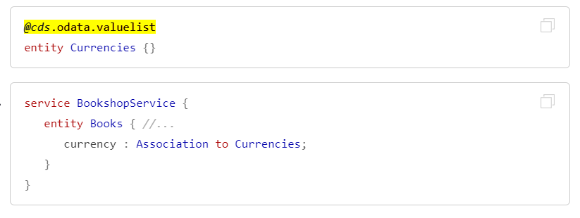
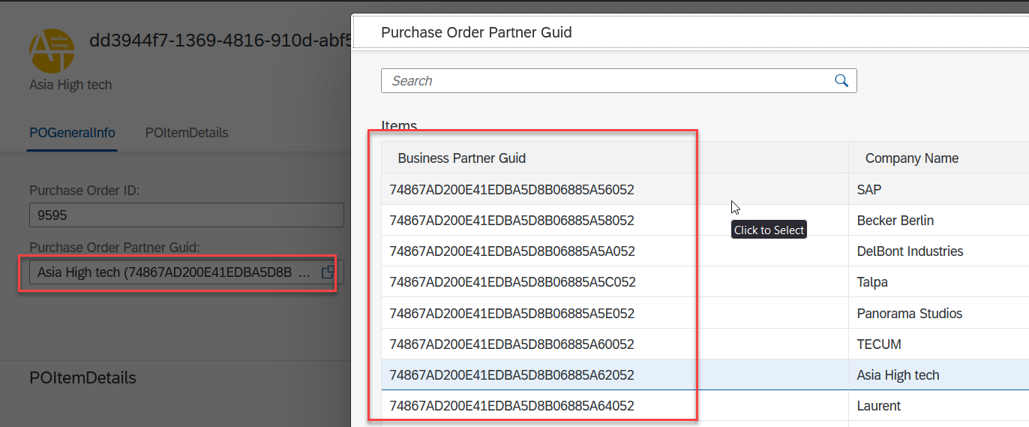
Value Help Integrations in CAPM
Simply add the @cds.odata.valuelist annotation to an entity, and all managed associations targeting this entity will automatically receive Value Lists in SAP Fiori clients. For example:
www.anubhavtrainings.com

Slide 10
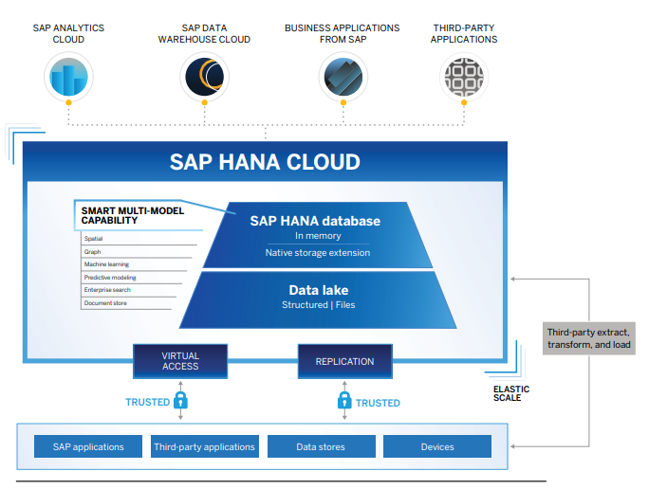
What is SAP HANA Cloud in BTP?
SAP HANA Cloud is a single database as a service (DBaaS) foundation for modern applications and analytics across all enterprise data.
SAP HANA Cloud delivers scalability, speed, and flexibility with elastic pricing to adapt to your changing needs and in-memory processing to significantly reduce your response
With SAP HANA Cloud, you can store and process multiple types of business data – including spatial, graph, hierarchy, document, and SQL.
It also helps you perform advanced analytics on live transactions without tuning your machine learning models. And you can use advanced analytics to build custom applications with high data volumes.
www.anubhavtrainings.com

Slide 11

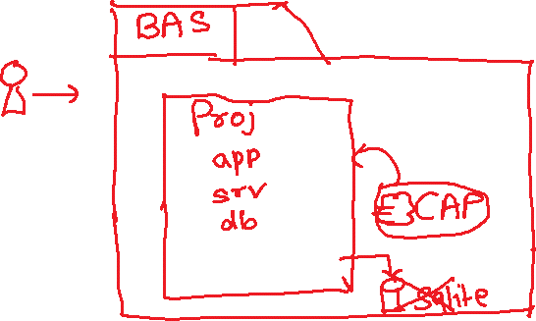










Slide 12
















Slide 13

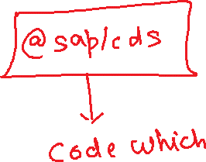





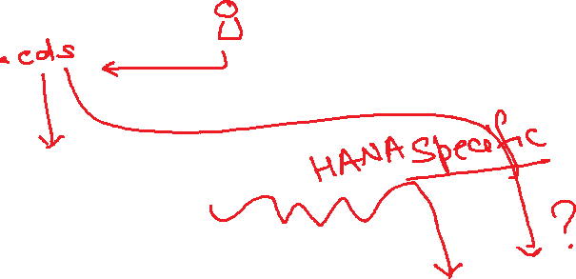


Slide 14
What is HDI – HANA Deployment Infrastructure
Applications
NodeJS
@sap/hdi-deploy
Tables, views, procedures, functions, sequences, cubes, triggers, …..
Service layer HDI
HANA > 50,000 USD
HDI Container
HDI Container
HDI Container
HDI Container
HDI Container
HDI Container
HDI Container
HDI Container
HDI Container
HDI Container
HDI Container
HDI Container

Slide 15
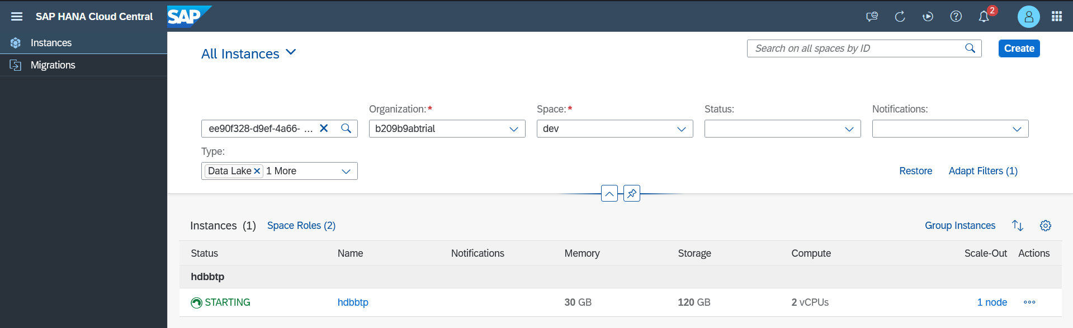
Setup SAP HANA Cloud DB free tier in BTP
www.anubhavtrainings.com

Slide 16
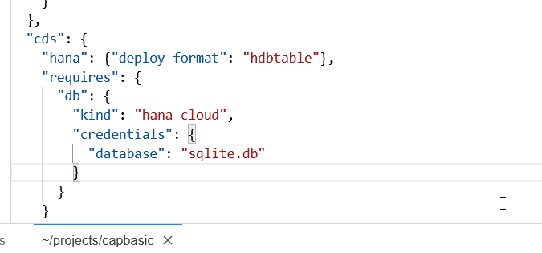
Connect, Build and Deploy to SAP HANA Cloud
Checked the version of CDS (which must be > 2.0) cds –v
Started a HANA Cloud instance in SAP BTP
We added SAP HANA configuration so our app can talk to HANA cds add hana
Added hana deployment config to tell CAPM that our format for deployment is hdbtable under cds section
"hana": {
"deploy-format": "hdbtable"
},
5. We add hana db module npm add hdb
6. Build hana specific artefacts cds build –production
7. Must login to CF cf login
8. Finally we deploy to HANA to create physical DB Object cds deploy --to hana:mickey
9. Create a new mta.yaml instead of manifest.yml, cds add mta
10. We manually added our UI Module with require as srv-api
11. Inside the app folder we added package.json with @sap/approuter module
12. Added start script for package.json with approuter.js
13. Added xs-app.json file for the routes
14. Open terminal, go to project dir, command mbt build
15. Created a new folder mta_archieve and inside that a .mtar file was create
16. We can go to CF->dev space and can see the CF microservice
www.anubhavtrainings.com

Slide 17
Cloud MTA Build Tool
Introduction
The Cloud MTA Build Tool is a standalone command-line tool that builds a deployment-ready multitarget application (MTA) archive .mtar file from the artifacts of an MTA project according to the project’s MTA development descriptor (mta.yaml file), or from the module build artifacts according to the MTA deployment descriptor (mtad.yaml file).
The archive builder is used on a file system that is independent from the development environment where the application project was created.
The archive builder is supported on Windows and Linux operating systems.
https://sap.github.io/cloud-mta-build-tool/
www.anubhavtrainings.com

Slide 18
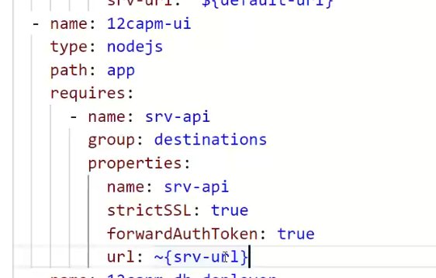
Add UI Module manually
- name: capbasic-ui
type: nodejs
path: app
parameters:
buildpack: nodejs_buildpack
requires:
- name: srv-api
group: destination
properties:
name: srv-api
strictSSL: true
forwardAuthToken: true
url: '~{srv-url}'
www.anubhavtrainings.com

Slide 19
App Router
It is a node js Application
It is used to automate our process of authorization and XSUAA token management
Redirects the access of our Microservice to XSUAA, XSUAA redirects it to IDP
IDP sends the login screen to the user, user authenticates and XSUAA release a JWT Token
App Routes takes this JWT Token, validates it and fowardAuthToken to the microservice
It serves as a single entry point for our application which perhaps has multiple microservices inside.
This configuration of each microservice to which we need to re-direct is managed using a configuration file which app router will use called xs-app.json
URL
App Router
(Reverse Proxy, Single Entry point, Façade)
xs-app.json
Java
/anubhav.svc
Node
/vendors
Fiori UI5
/index.html
www.anubhavtrainings.com

Slide 20
Banking example from Real world
Locker
Gold Loan
Home Loan
Core banking
Cheque Service
RD and FDs
www.anubhavtrainings.com

Slide 21
xs-app.json App Router Configuration
{
"welcomeFile": "purchaseorderapp/webapp/",
"authenticationMethod": "none",
"sessionTimeout": 10,
"pluginMetadataEndpoint": "/metadata",
"routes": [
{
"source": "^/purchaseorderapp/webapp/(.*)",
"target": "$1",
"localDir": "purchaseorderapp/webapp/"
},
{
"source": "^/(.*)$",
"destination": "srv-api"
}
]
}
www.anubhavtrainings.com

Slide 22
Title
www.anubhavtrainings.com

Slide 23
URL
xs-app.json
routes
AppRouter – Node Module - @sap/approuter
Provide single entry point for application
Interservice communication w/o CORS
Help in security
ui
srv
srv2
srv3
/pord/index.html
/catalogsrv
/myservice
/newsrv3

Slide 24
Add UI Module manually
- name: capbasic-ui
type: nodejs
path: app
parameters:
buildpack: nodejs_buildpack
requires:
- name: srv-api
group: destination
properties:
name: srv-api
strictSSL: true
forwardAuthToken: true
url: '~{srv-url}'
www.anubhavtrainings.com

Slide 25
App Router
It is a node js Application
It is used to automate our process of authorization and XSUAA token management
Redirects the access of our Microservice to XSUAA, XSUAA redirects it to IDP
IDP sends the login screen to the user, user authenticates and XSUAA release a JWT Token
App Routes takes this JWT Token, validates it and fowardAuthToken to the microservice
It serves as a single entry point for our application which perhaps has multiple microservices inside.
This configuration of each microservice to which we need to re-direct is managed using a configuration file which app router will use called xs-app.json
URL
App Router
(Reverse Proxy, Single Entry point, Façade)
xs-app.json
Java
/anubhav.svc
Node
/vendors
Fiori UI5
/index.html
www.anubhavtrainings.com

Slide 26
Banking example from Real world
1
Single entry point
(App Router)
xs-app.json
Bank Service
(Microservice)
0145
6
2
Locker
5
Gold Loan
authentication
IB
IDP
JWT
Home Loan
3
Token Machine
XSUAA
ROLES
Core banking
4
Xsuaa backing service
0145
Cheque Service
RD and FDs
authorization
www.anubhavtrainings.com

Slide 27
xs-app.json App Router Configuration
{
"welcomeFile": "purchaseorderapp/webapp/",
"authenticationMethod": "none",
"sessionTimeout": 10,
"pluginMetadataEndpoint": "/metadata",
"routes": [
{
"source": "^/purchaseorderapp/webapp/(.*)",
"target": "$1",
"localDir": "purchaseorderapp/webapp/"
},
{
"source": "^/(.*)$",
"destination": "srv-api"
}
]
}
www.anubhavtrainings.com

Slide 28
Authentication v/s Authorization
Authentication – Are you a valid user? User credentials validated. – user Account
Authorization – What is user allowed to access with the app?
XSUAA – User Account and Authorization
This is a in-built component inside of SAP CF
It is responsible to control the User account and Authorization
In Cloud Foundry, we can use a modular concept for managing Authorizations
We need to register our Scopes, Role Templates related to the app with XSUAA
Communicates with IDP
Issues JWT Tokens which is then injected in our App which has information about Scope(Role) user has
Scope
(Role)
Role Templates
Role Collections
* *
* *
* *
www.anubhavtrainings.com

Slide 29
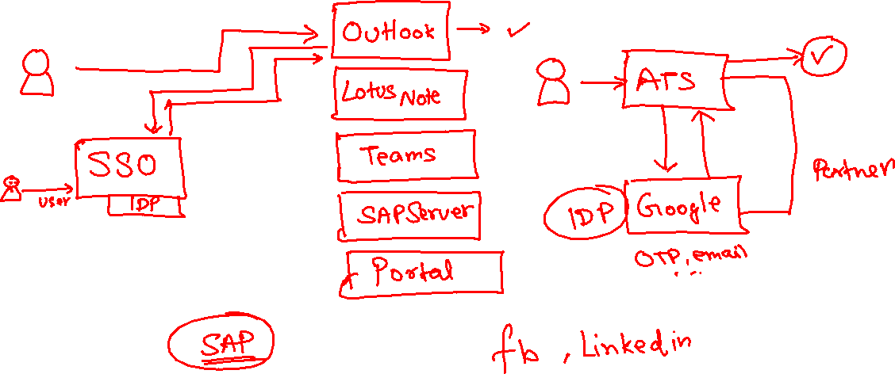
IdP – Identity Provider
www.anubhavtrainings.com

Slide 30
Process Of Implementation
Create a New backing service instance for XSUAA
While creating this instance we need to pass our Role Configuration (JSON) = xs-security.json
Documentation for making xs-security file
https://help.sap.com/viewer/4505d0bdaf4948449b7f7379d24d0f0d/2.0.03/en-US/6d3ed64092f748cbac691abc5fe52985.html
We need to bind our app with this backing service
If we use Java, we need to add a security module (Spring) to restrict access to end points
https://github.com/SAP/cloud-security-xsuaa-integration
Deploy and Test our app
{
"xsappname": "07springodata",
"tenant-mode": "dedicated",
"scopes": [{
"name": "$XSAPPNAME.AnubhavDisplay",
"description": "To Display vendor data"
},
{
"name": "$XSAPPNAME.AnubhavEdit",
"description": "To Create new vendor data"
}
],
"role-templates": [{
"name": "Viewer",
"description": "View, Vendor Details",
"scope-references": [
"$XSAPPNAME.AnubhavDisplay"
]
},
{
"name": "Editor",
"description": "Edit and Create new Vendor Details",
"scope-references": [
"$XSAPPNAME.AnubhavEdit"
]
}
]
}
www.anubhavtrainings.com

Slide 31
Obtaining JWT Token from XSUAA
Create a POST call to XSUAA service to obtain JWT token
Type: POST
URL : <url from CF>/oauth/token
Body – x-www-url-encoded
(examples)
client_id - <get from cf>
client_secret - <get from cf>
username – <pass your CF email id>
password – <your CF password>
grant_type – password
response_type – token
2. Call your Service - https://07springodata-smart-wolverine-rk.cfapps.eu10.hana.ondemand.com/anubhav.svc
Type: GET
Headers –
Authorization : Bearer <token which we obtain in last step>
Content-Type : application/json
www.anubhavtrainings.com

Slide 32
Authorizations Control
www.anubhavtrainings.com

Slide 33
Security – Authentication/Authorization
Create a entry for cloud foundry managed service of type xsuaa in mta.yaml file
Add that as a require resource into the system
Create a xs-security.json file with the required configuration, Roles, Role Template, Attribute
Go to xs-app.json file, add the authentication method as route And also add the "authenticationType": "xsuaa",
Install the dependencies for passport, @sap/xsenv, @sap/xssec
Add the configuration for security in package.json inside cds section
"uaa": {
"kind": "xsuaa"
}
Add authentication strategy with optional dev profile so that we can configure local test users
Make sure our resources are protected, CatalogService.cds, go and add authentication force and then authorization control for entity (Row level security)
@(requires: 'authenticated-user')
@(restrict:[
{
grant: ['READ'],
to: 'Viewer',
where: 'bankName = $user.BankName'
},
{
grant: ['WRITE'],
to: 'Admin'
}
])
www.anubhavtrainings.com

Slide 34
Title
www.anubhavtrainings.com

Slide 35
Title
www.anubhavtrainings.com

Slide 36
Title
www.anubhavtrainings.com

Slide 37
Title
www.anubhavtrainings.com

Slide 38
Title
www.anubhavtrainings.com

Slide 39

Summarize
LET’S SUMMARISE!

Slide 40

Summarize
End of Day 15

Slide 42


We’re committed to empower you to be
#FutureReady
through powerful training solutions.
We build the workforce of the future.
250+
Corporate Clients
30,000+
Learners Trained
25000+
Learners Placed
FREE WEBINARS
Sign up for free webinars with industry experts every fortnight!
Enroll Now!
Contact us today!
https://anubhavtrainings.com

